Slide 1
Article: Detailed observation of California foreshock sequences: Implications for the earthquake initiation process Authors: Dodge, Beroza and Ellsworth (1996)
Earthquake precursors – Reading group

Slide 2
Introduction
Initiation process: same for small and big earthquakes?
Quasi-static slip within a nucleation zone
May be detectable if nucleation zone large enough BUT no observation to date
Foreshocks part of nucleation
Not closely analyzed
Location uncertainties too important
Dodge et al. (1995) relocation of Landers foreshocks sequence
At 100m horizontally and 200m vertically
Useful to define nucleation process
Cascading failure process
Aseismic process

Slide 3
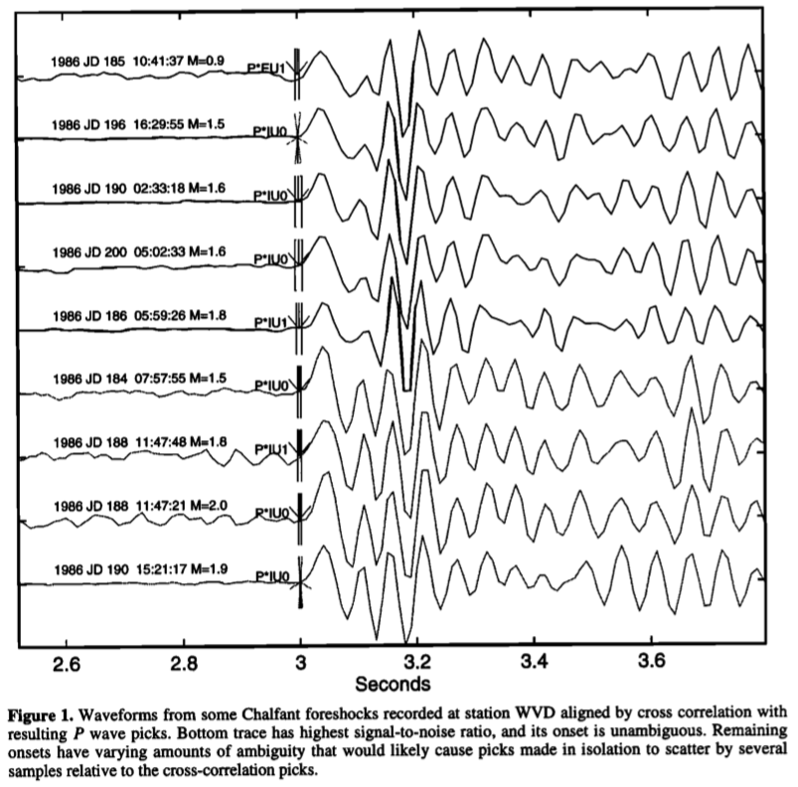
Relocation Procedure
Velocity model and station corrections
VELEST earthquake location program [Ellsworth, 1977; Roecker, 1981]
P & S wave arrival picks
Separate groups in seismogram sequence
VanDecar and Crosson [1990] technique in each group
Cross correlations + weighted least squares adjustment
Hand picks on the highest signal-to-noise ratio

Slide 4
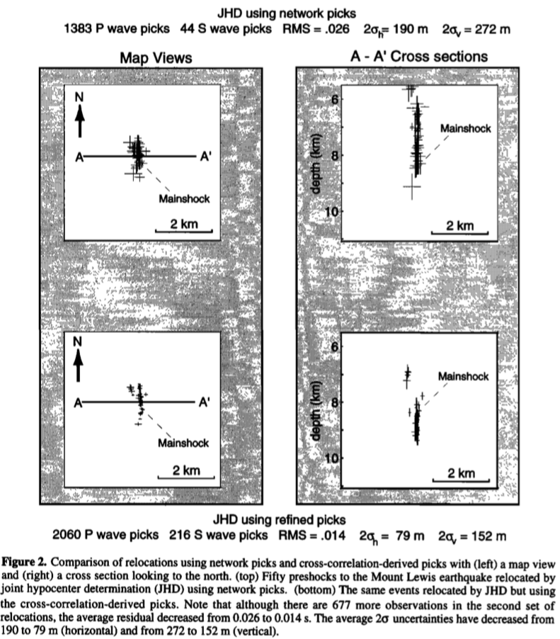
Relocation
N-S trending visible on both
Visible with this study:
Change in strike ~1km from southern end
Northwest branch of seismicity
For this study:
800 additional observations
Residual/2
Smaller standard errors

Slide 5
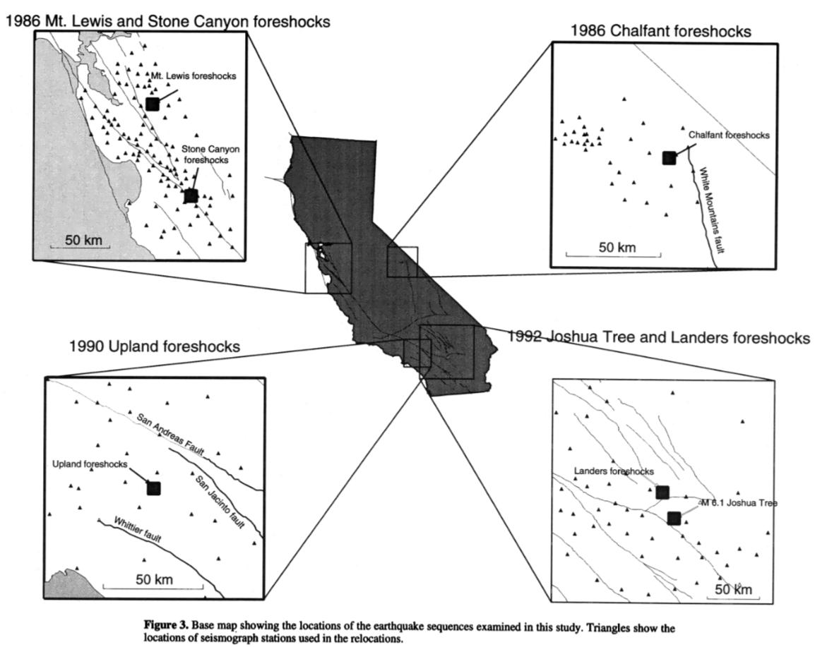
Foreshock Sequences
M_{L} 5.7
M_{L} 4.7
M 5.8
M_{L} 5.2
M_{W} 7.3
M_{W} 6.1

Slide 6
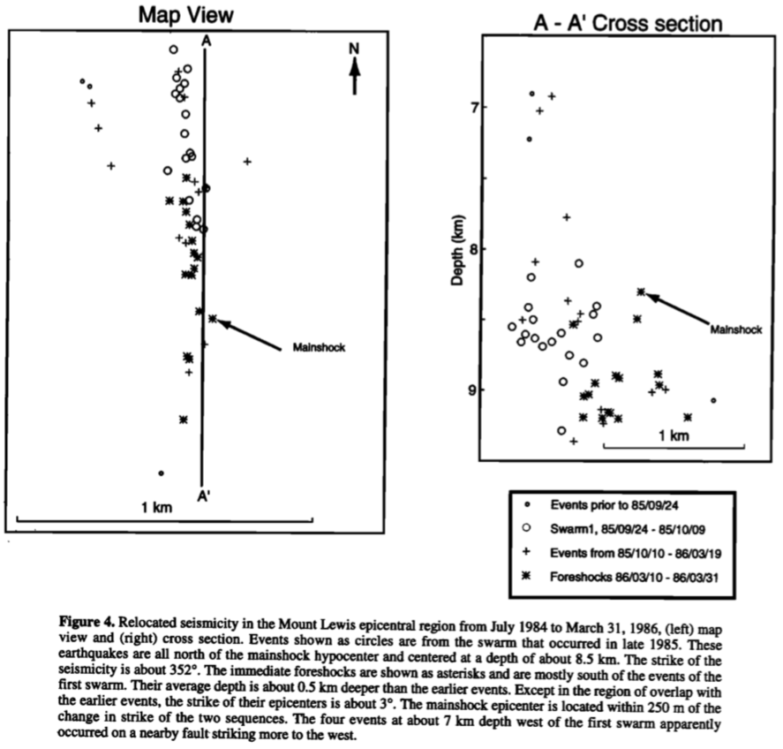
Mount Lewis Sequence (1986)
1st swarm:
~19 events
Active 2 weeks from September 24, 1985
2nd swarm:
Immediate foreshocks
18 events
25 days before mainshock

Slide 7
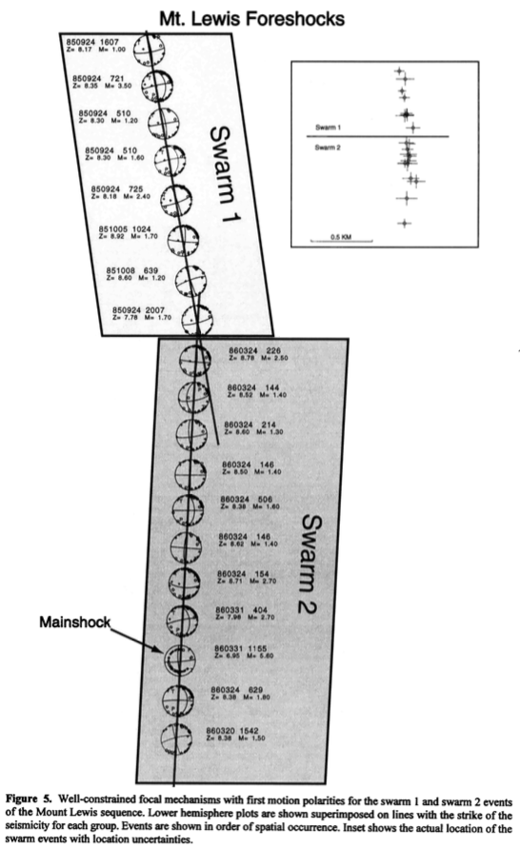
Mount Lewis Sequence (1986)
Zhou et al. [1993]: 2 groups focal mechanisms:
Strike of 355°
Strike of 5°
This study:
Swarm 1: strike 351° +/- 2.6°
Swarm 2: strike 1° +/- 2.1°

Slide 8
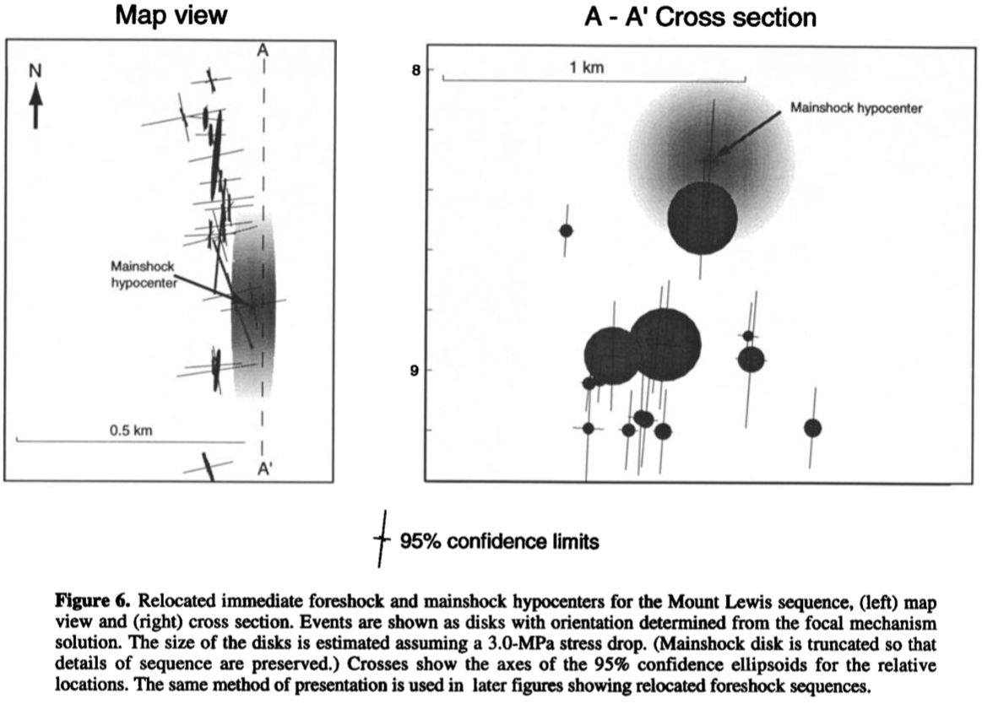
Mount Lewis Sequence (1986)
M_{L} 2.7
8h prior the mainshock

Slide 9
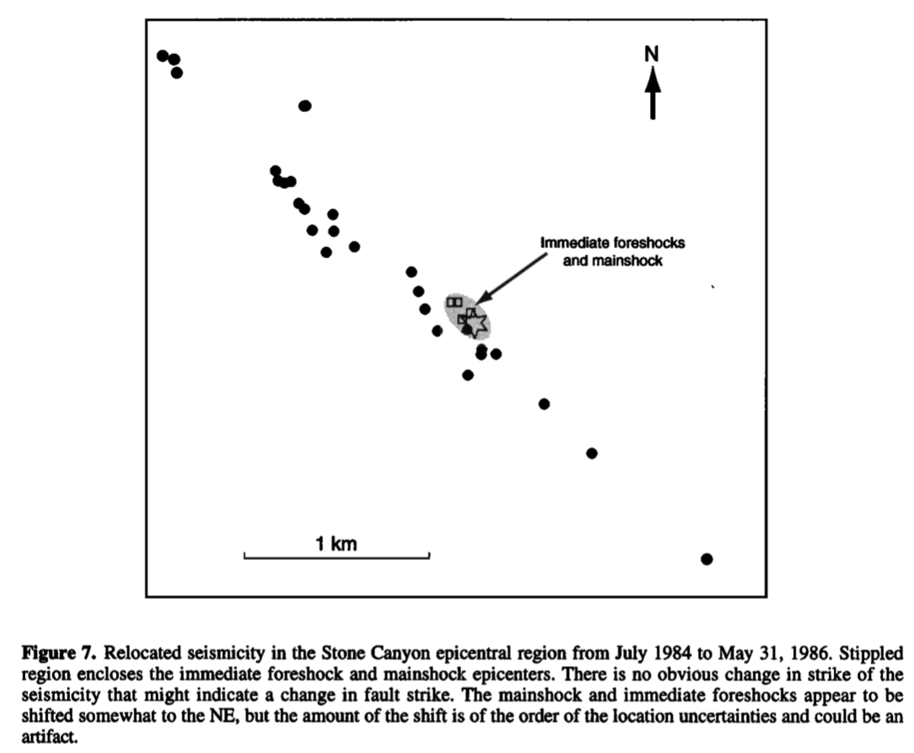
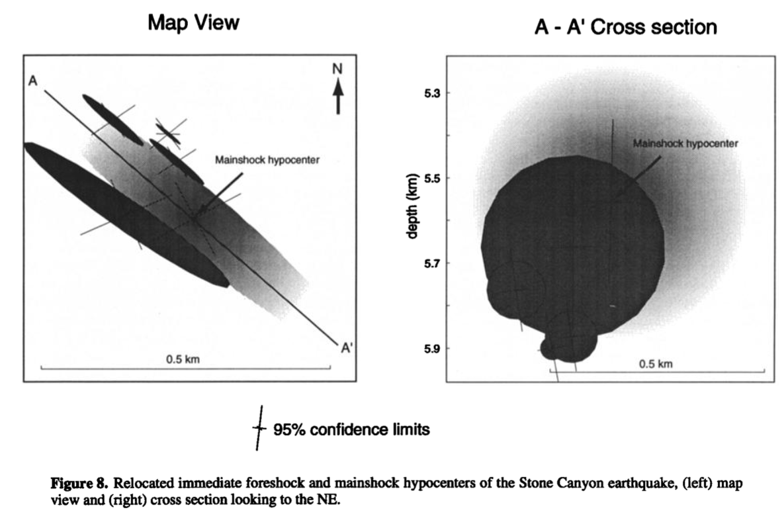
Stone Canyon Sequence (1983)

Slide 10
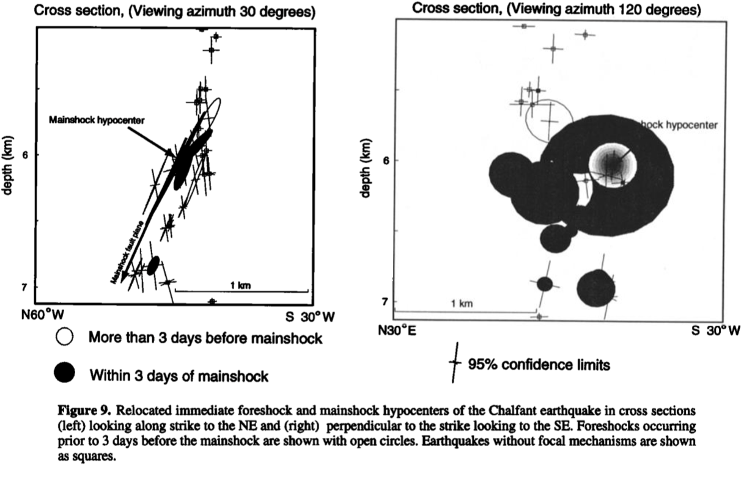
Chalfant Sequence (1986)

Slide 11
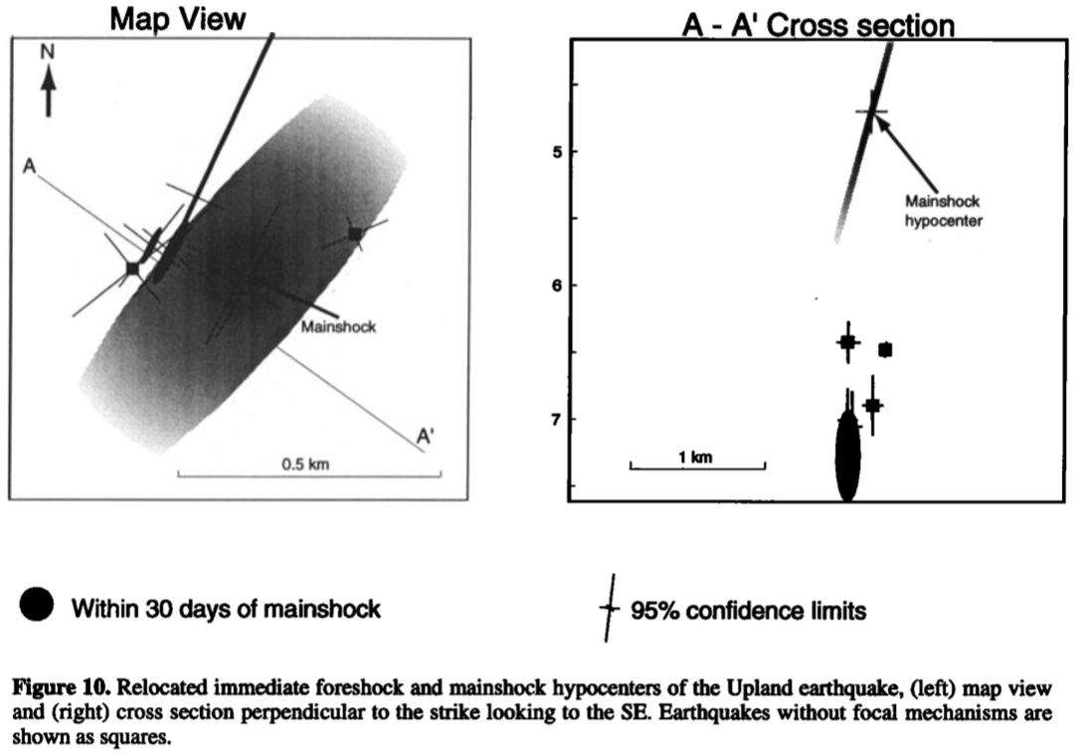
Upland Sequence (1990)

Slide 12
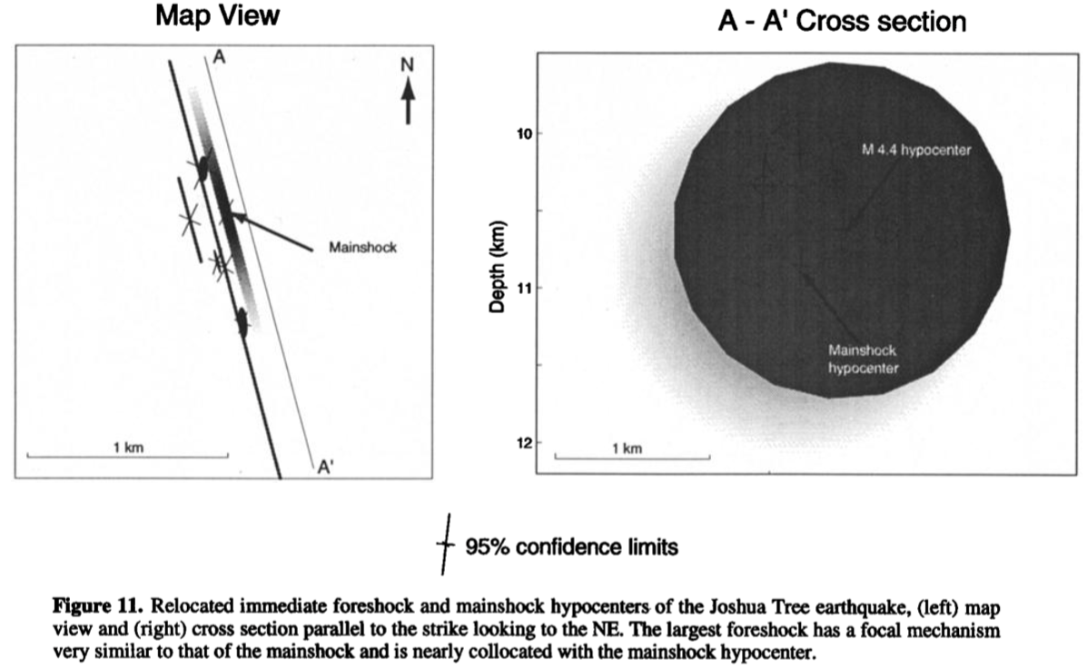
Joshua Tree Sequence (1992)

Slide 13
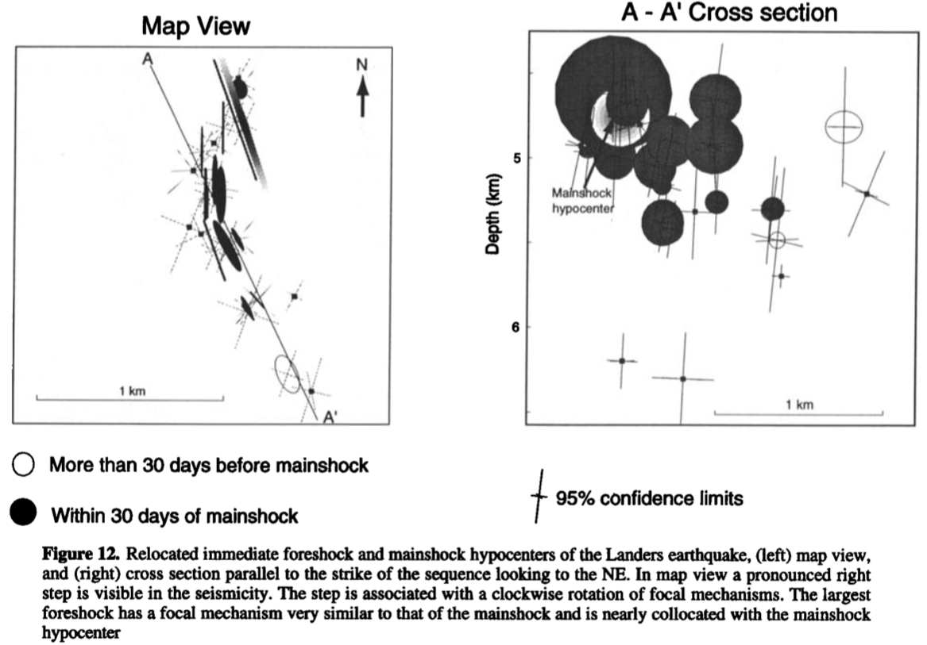
Landers Sequence (1992)

Slide 14
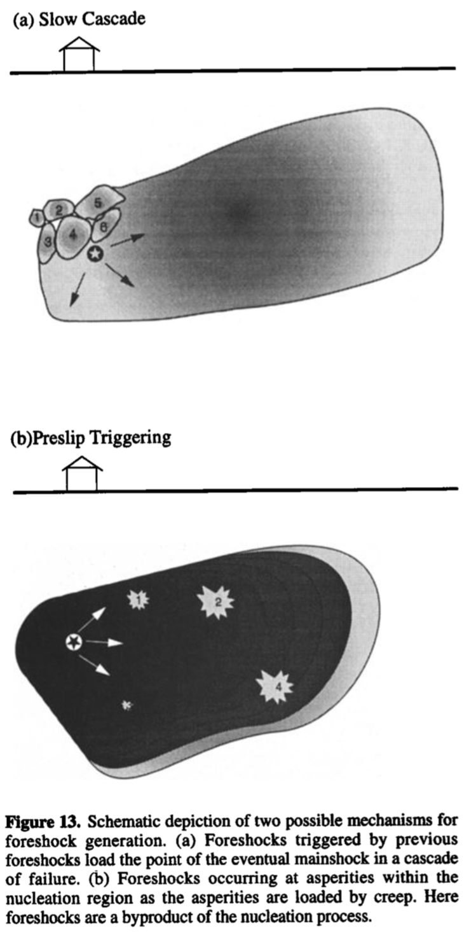
Stress Change Calculation
Cascade model:
Initial event → sequence → mainshock
Triggering through
Static stress changes
Pore pressure changes
Dynamic effects (not study here)
Preslip model:
Aseismic process in nucleation zone
Foreshock = failure within the nucleation zone
Test of static stress and pore pressure changes to choose between both model

Slide 15
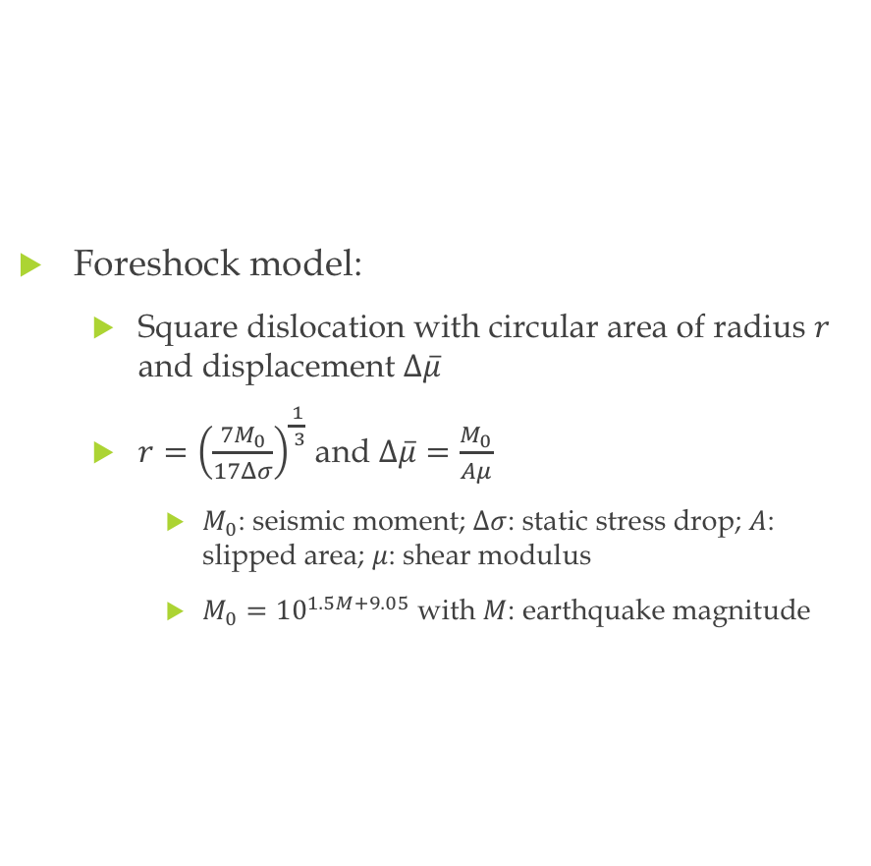
Stress Change Calculation
Cumulative stress calculated ~ Mainshock failure mechanism ?
Uncertainties:
Geometrically complex fault → rectangular planes
Approximation of actual slip
Earth = elastic half-space
Unknown factors → assumed coefficient of friction
Foreshock model:
Square dislocation with circular area of radius $r$ and displacement $Δ\overline{μ}$
$r={\left(\frac{7M_{0}}{17Δσ}\right)}^{\frac{1}{ 3}}$ and $Δ\overline{μ}=\frac{M_{0}}{Aμ}$
$M_{0}$: seismic moment; $Δσ$: static stress drop; $A$: slipped area; $μ$: shear modulus
$M_{0}={10}^{1.5M+9.05}$ with $M$: earthquake magnitude

Slide 16
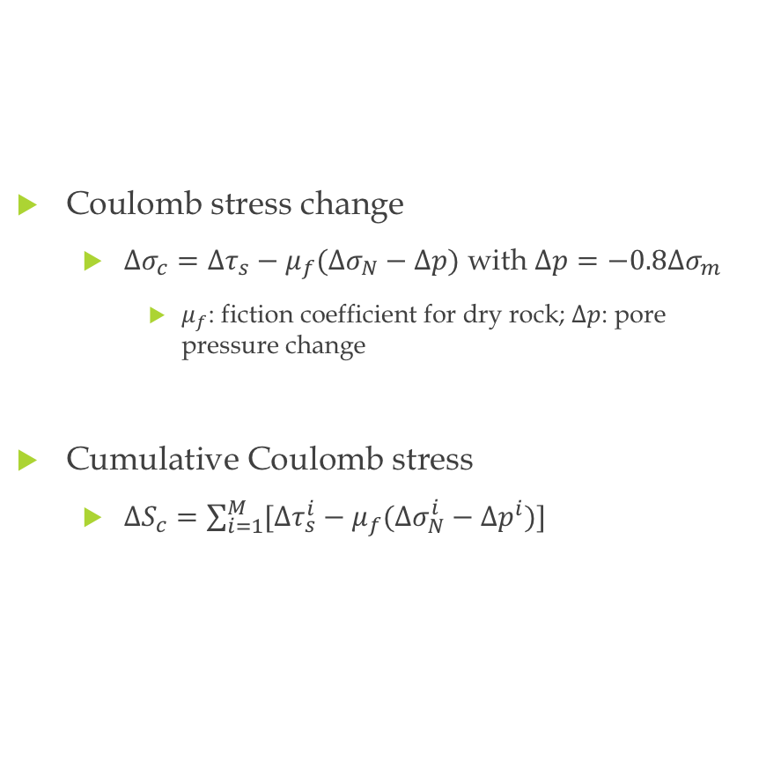
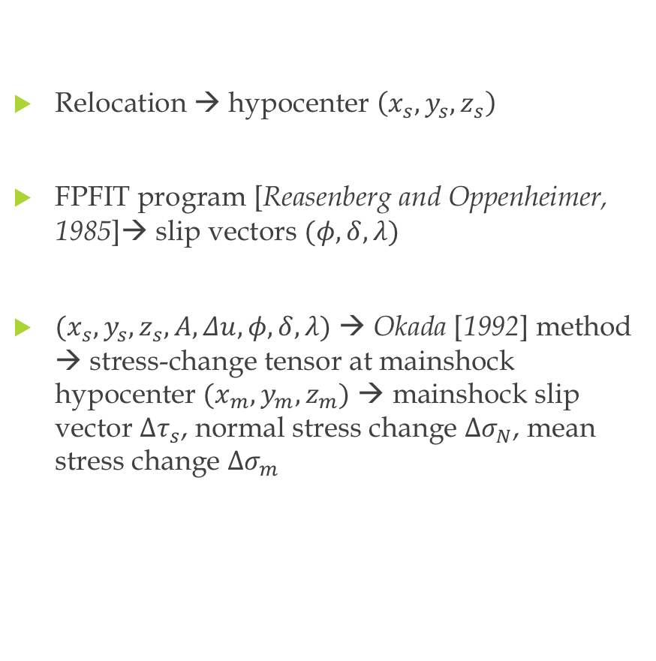
Stress Change Calculation
Relocation → hypocenter $\left(x_{s},y_{s},z_{s}\right)$
FPFIT program [Reasenberg and Oppenheimer, 1985]→ slip vectors $(φ,δ,λ)$
$(x_{s},y_{s},z_{s},A,Δu,φ,δ,λ)$ → Okada [1992] method → stress-change tensor at mainshock hypocenter $(x_{m},y_{m},z_{m})$ → mainshock slip vector $Δτ_{s}$, normal stress change $Δσ_{N}$, mean stress change $Δσ_{m}$
Coulomb stress change
$Δσ_{c}=Δτ_{s}−μ_{f}(Δσ_{N}−Δp)$ with $Δp=−0.8Δσ_{m}$
$μ_{f}$: fiction coefficient for dry rock; $Δp$: pore pressure change
Cumulative Coulomb stress
$ΔS_{c}=\sum_{i=1}^{M}{[Δτ_{s}^{i}}−μ_{f}(Δσ_{N}^{i}−Δp^{i})]$

Slide 17
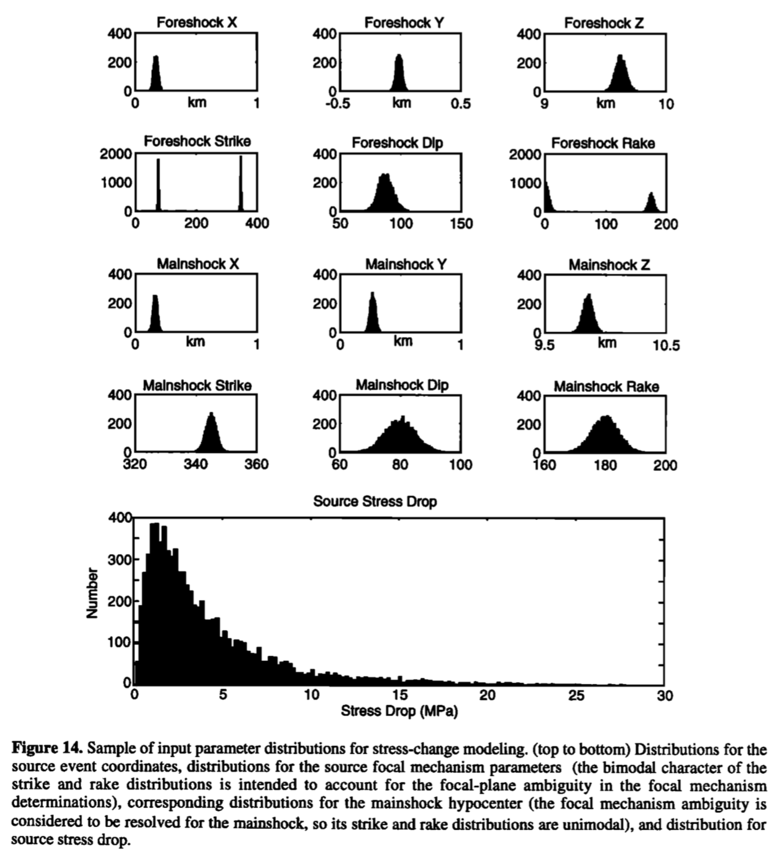
Stress Change Calculation
Uncertainties problem
Variables = random variables
Errors: normally distributed with zero mean
Hypocenter location: distribution centered on nominal value, variance taken from solution covariance
Focal mechanism parameters: variance = (parameter uncertainty from FPFIT)²
Stress drops: lognormally distribution with 3.0MPa mean and 99% in [0.1;100]MPa

Slide 18
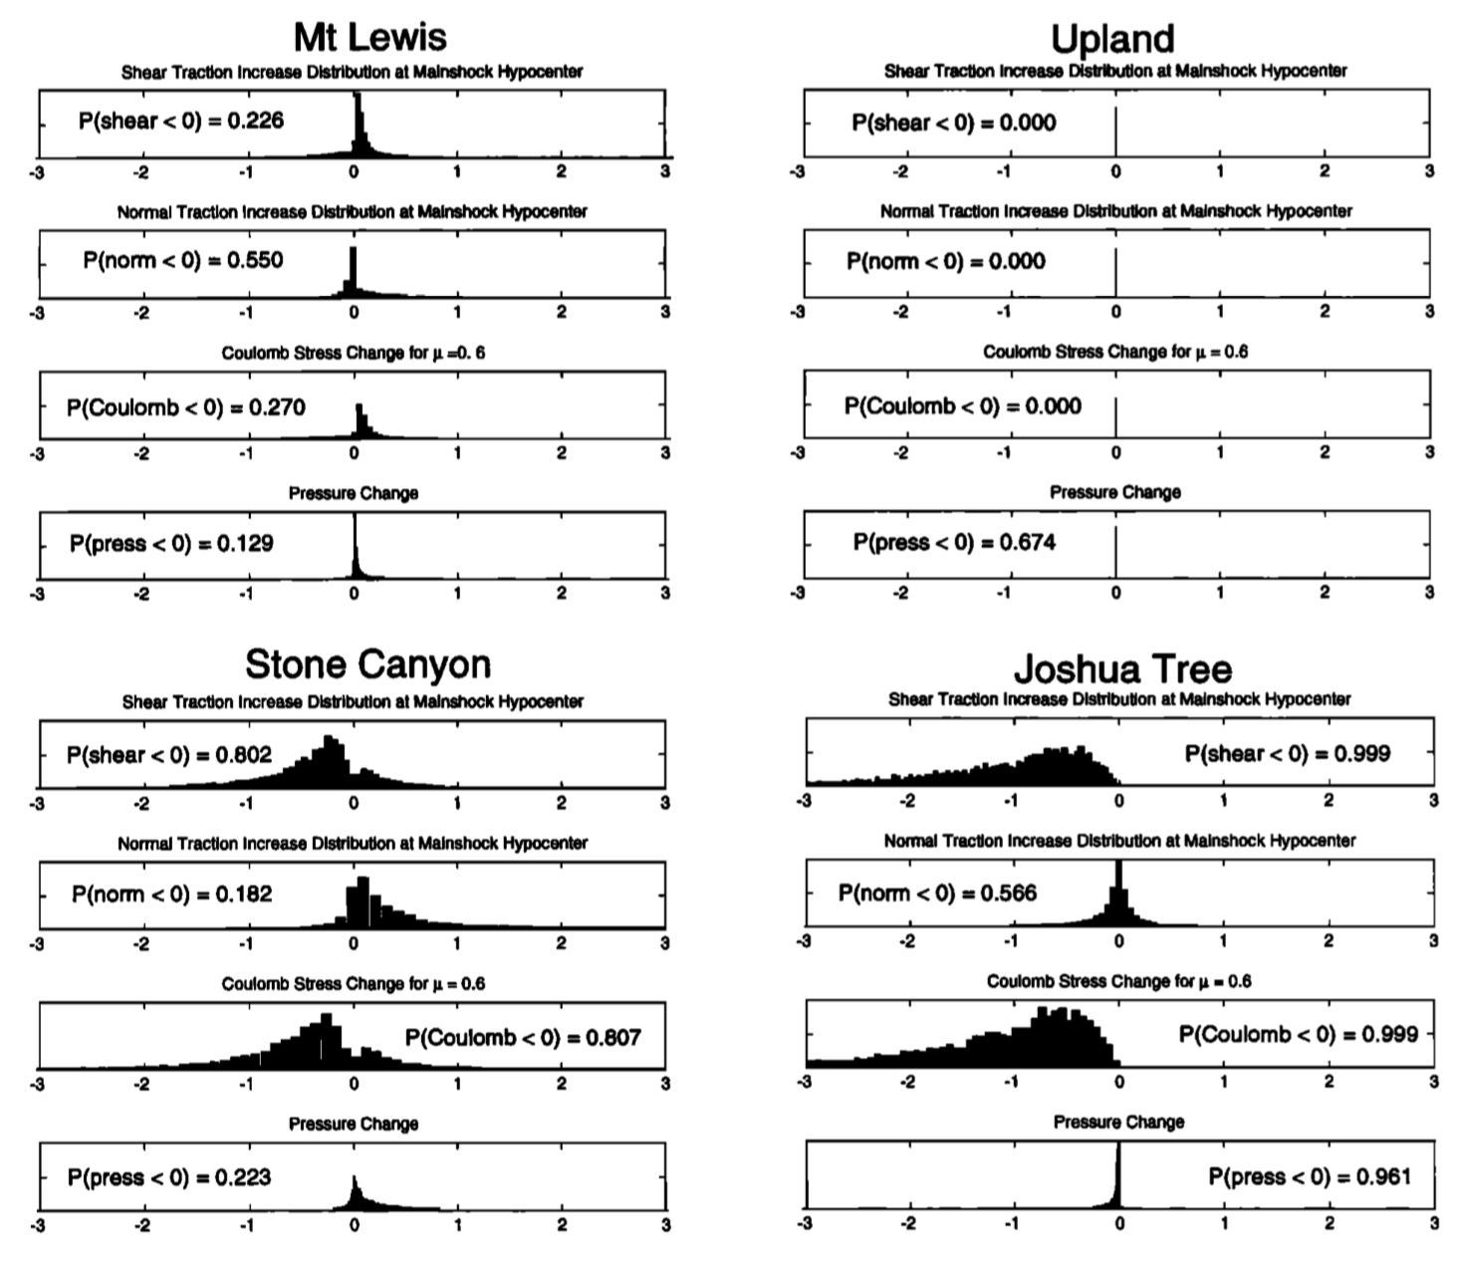
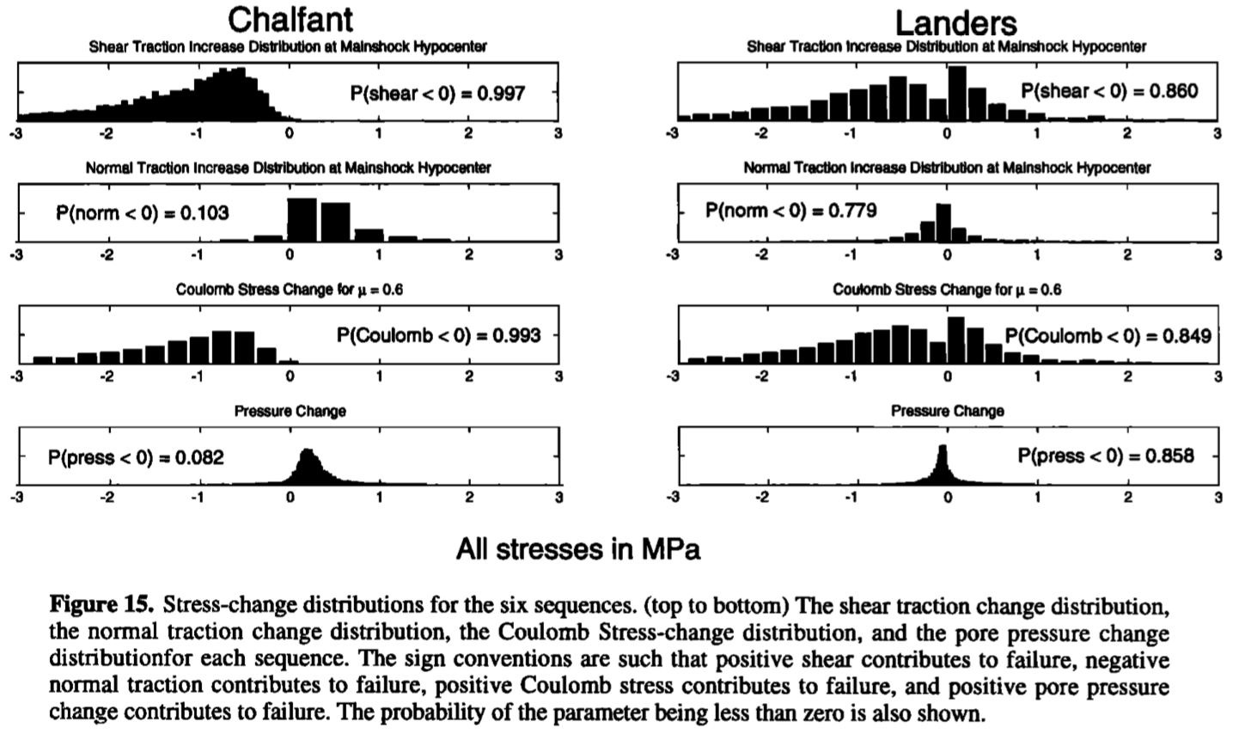
Stress Change Calculation
Cascade model
~Preslip model
Preslip models
Preslip model
Preslip model

Slide 19
Discussion
Coulomb stress
4/6: no trigger
Upland: consistent with triggering but too small
Mount Lewis: consistent with triggering
Pore fluids → accelerate stress corrosion
Stone Canyon, Chalfant: pore pressure increase → indirectly trigger of mainshock
Possibilities of trigger no considered
High-pressure fluid communicating through the fault zone
Dynamic stresses
Aseismic nucleation process
Foreshock = by-product of process
Stress changes from foreshock not linked to failure mechanism of the mainshock
Stress changes observation compatible
Foreshocks location and kinematic → size of nucleation zone, relation to mainshock magnitude

Slide 20
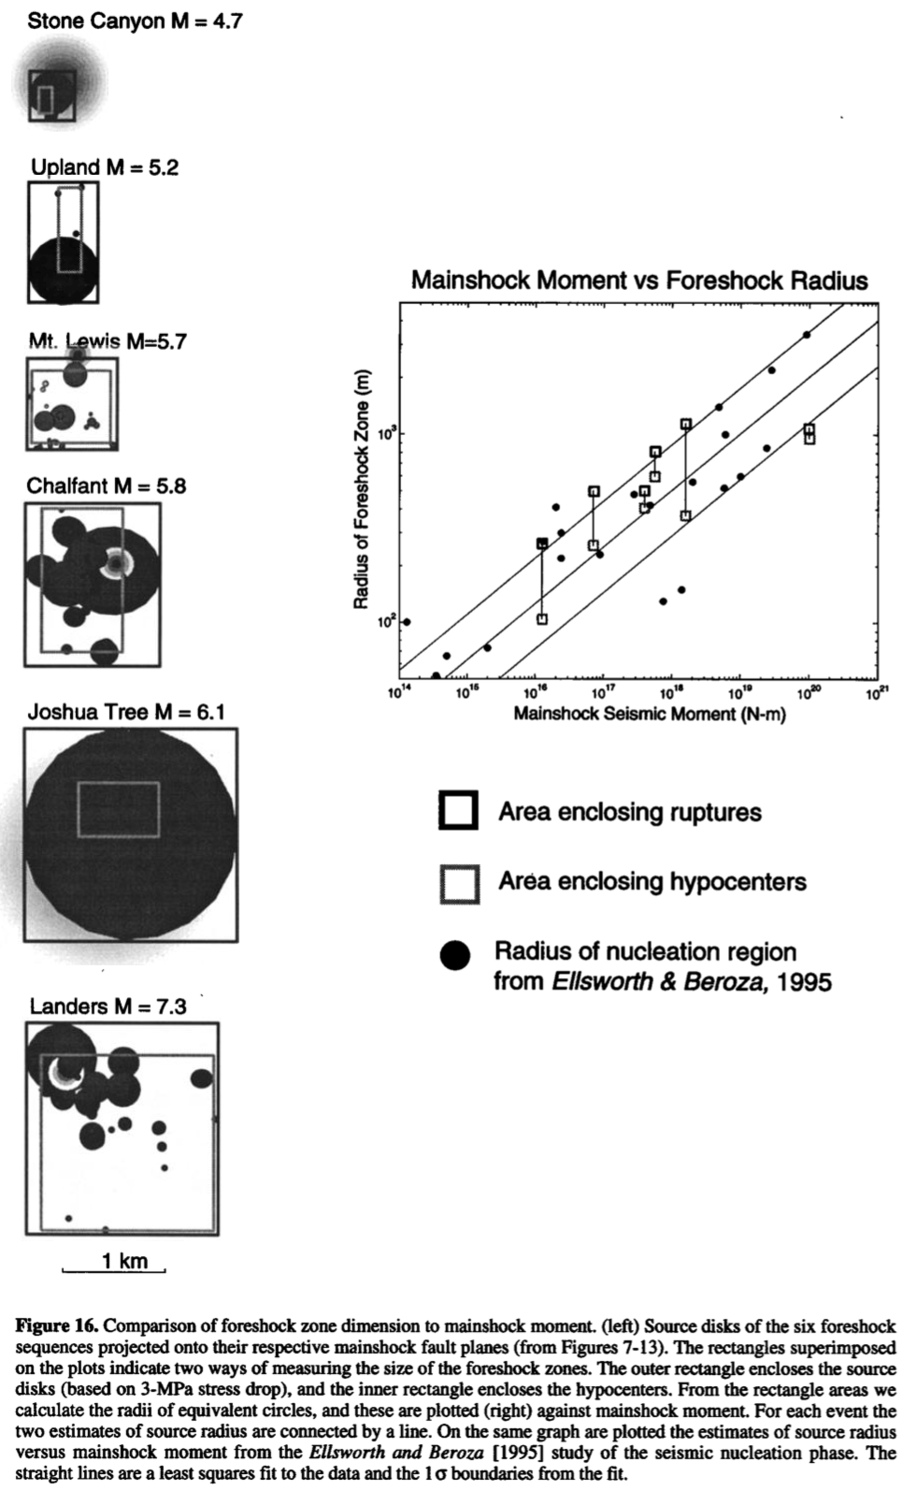
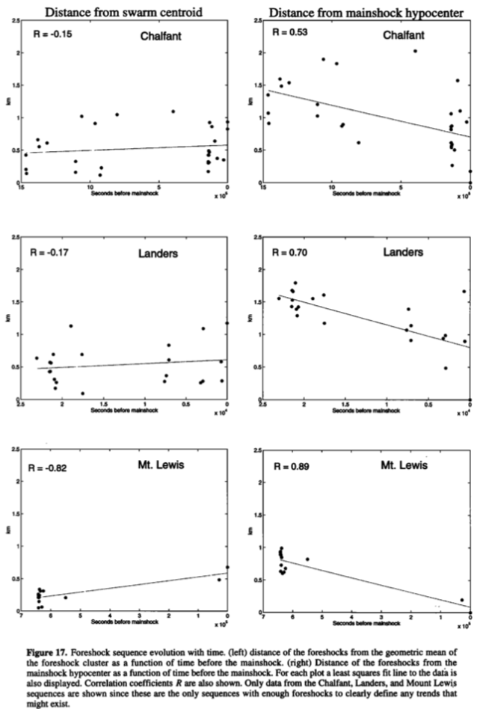
Discussion

Slide 21
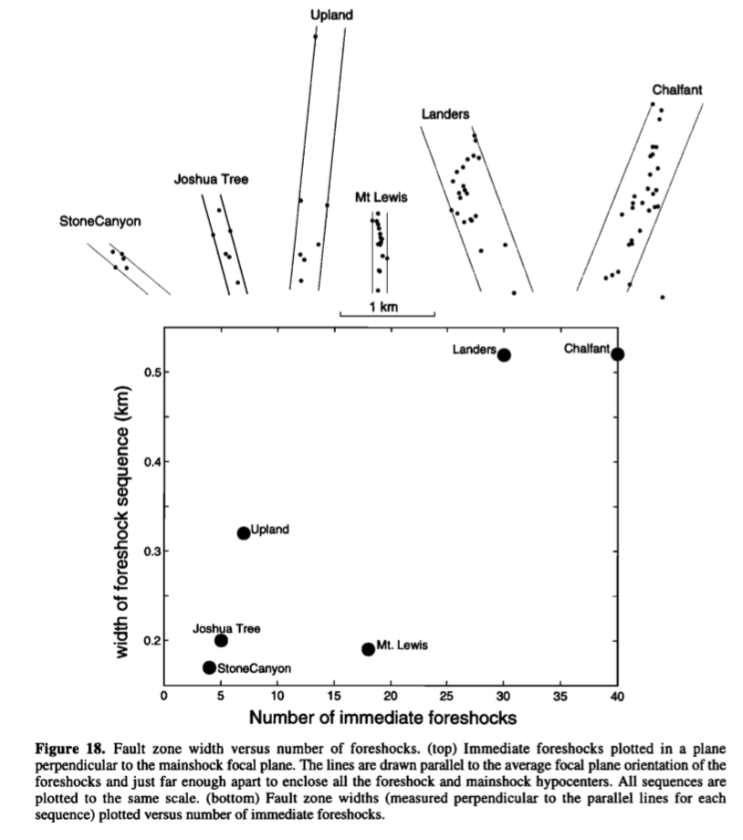
Discussion

